Slide 1
Analyzing Health Equity Using Household Survey Data
Lecture 16
Who Pays for Health Care? Progressivity of Health Finance
Notes:
1. Who pays for health care? To what extent are payments toward health care related to ability to pay? Is the relationship proportional? Or is it progressive—do health care payments account for an increasing proportion of ability to pay (ATP) as the latter rises? Or, is there a regressive relationship, in the sense that payments comprise a decreasing share of ATP? The preferred relationship between health care payments and ATP will vary across individuals with their conceptions of fairness. But identification of the nature of the empirical relationship and quantification of the degree of any progressivity or regressivity is of interest, not only from a wide range of equity perspectives, but also for macroeconomic and political analyses of the health care system.

Slide 2
What is progressivity?
A vertical equity concept – extent to which those with unequal ability to pay do pay differentially for health care
The extent to which payments for health care are proportional to ability to pay
Progressive - payments are an increasing proportion of ability to pay.
Regressive – payments are a decreasing proportion of ability to pay.
Proportional – payments remain a constant proportion of ability to pay.
Notes:
1. This lecture provides practical advice on methods for assessing and measuring progressivity in health care finance. Throughout, we measure progressivity through departures from proportionality in the relationship between payments toward the provision of health care and ATP. There are other approaches to the measurement of progressivity (Lambert 1993). The relationship between progressivity and the redistributive impact of health care payments is considered in the next chapter.

Slide 3
Measuring progressivity
Two distinct stages:
  Measure progressivity of each source of health finance
  Weight each source to establish progressivity of health financing system in total
Stage 1 requires survey data on health payments, tax/social insurance contributions, health insurance premiums, etc
Stage 2 requires macro (National Health Accounts) data on the health financing mix
Notes:
1. There are two distinct stages to an analysis of progressivity. First, establish the progressivity of each source of finance. Second, establish the overall progressivity of the system by weighting the progressivity of the separate sources. Two types of data are required: survey data to establish the distribution of payments across households and aggregate data to determine the macroweights to be assigned to each finance source. The most suitable source of survey data is a household income and expenditure survey, which should contain good data on the two central variables: payments toward health care and ability to pay.

Slide 4
Definitions & measurement of key variables
Ability to pay
  proxied by income/expenditure/consumption (lecture 6)
  should indicate welfare before payments for health care
  Adjust for hhold size and structure through equivalence scale
Health care payments:
  Out of pocket (OOP) payments
  Private insurance
  Social insurance
  Taxation (direct and indirect, earmarked and non-earmarked)
Non specific sources of finance allocated pro-rata to share of total health sector finance.
Notes:
In principle, ATP should indicate welfare before payments for health care, and so measurement of ATP by consumption requires an assumption, most probably a strong one, that the means of financing health care does not affect saving decisions. Household consumption net of expenditures assumed nondiscretionary, such as those on food, is often used as a measure of welfare (World Health Organization 2000). For the purpose of assessing progressivity, such a measure of ATP can be problematic, depending on the objective, if the nondiscretionary expenditures are, in fact, sensitive to the system of health finance. For example, the relative tax rate imposed on food would be expected to differentially influence household decisions with respect to food spending. Then the distribution of household consumption net of food expenditure is itself a product of the health finance system and does not provide a benchmark against which to assess the distributional impact of that system. But if the objective is simply to assess the degree of proportionality between health payments and some measure of living standards, then household expenditures gross or net of those on food can be used, as preferred.
If one wishes to make an inference about the distributional impact of health finance (World Health Organization 2000), then the measure of ATP should be gross of all health care, tax, and social insurance payments. Out-of-pocket payments for health care should already be included in measures of household consumption/expenditure, but it will be necessary to add direct tax payments, social insurance contributions that contribute to health financing and, possibly, private health insurance premiums. If household income is used to proxy ATP, then it must be gross of tax and social insurance contributions, and one examines the impact of health financing on this benchmark distribution of income.
Evaluation of progressivity in health care finance requires examination of all sources of health sector funding and not simply those payments that are made exclusively for health care. So, in addition to out-of-pocket (OOP) payments, health insurance contributions, and earmarked health taxes, the distributional burden of all direct and indirect taxes is relevant in cases in which, as is commonly true, some health care is financed from general government revenues. Social insurance contributions should also be considered. One source of revenue, foreign aid, is not relevant because the purpose is to evaluate the distributional impact on the domestic population. Assuming tax parameters have been set for foreign loan repayment, the distributional burden on the current generation of foreign debt financing will be captured through evaluation of the tax distribution.

Slide 5
Incidence
Nominal payer not always the real payer.
But difficult to establish real incidence
Common incidence assumptions:
  • income and property taxes - legal taxpayer
  • corporate taxes - shareholder (or labor)
  sales and excise taxes - consumer
  • employer and employee SI/PI - employee
Sales tax – apply relevant rate to each item of exp.
Allocate taxes for which distribution cannot be estimated as taxes to which are most similar
Concentrate on allocating the main sources
Notes:
Progressivity analyses usually seek to determine the distribution of the real economic burden of health finance and not simply the distribution of nominal payments. So, the incidence of payments—who incurs their real cost—must be established, or assumed (Atkinson and Stiglitz 1980). For example, the results of employer contributions to health insurance is most likely lower wages received by employees. The extent to which this is true will depend on labor market conditions, in particular, the elasticities of labor demand and supply.
Given that incidence depends on market conditions, it cannot be determined through application of universal rules. However, a fairly conventional set of assumptions are given above.
Survey data are unlikely to provide complete information on household tax and insurance payments. For example, income tax payments or social insurance contributions may not be explicitly identified, and payments through sales taxes almost certainly will not be reported. Various approximation strategies are necessary. For example, tax and social insurance schedules can be applied to gross incomes/earnings.
The distribution of the sales tax burden can be estimated by applying product-specific tax rates to disaggregated data on the pattern of household expenditure.
Estimates of OOP payments from survey data are potentially subject to both recall bias and small sample bias owing to the infrequency with which some health care payments are made. Survey estimates of aggregate payments tend to show substantial discrepancies from production-side estimates, in cases in which the latter are available. Whether estimates of the distribution, as opposed to the level, of OOP payments are biased depends on whether reporting of OOP payments is related systematically to ATP. Under the possibly strong assumption of no systematic misreporting, survey data can be used to retrieve the distribution of payments, and mismeasurement of the aggregate level can be dealt with through application of a macroweight that gives the best indication of the relative contribution of OOP to total revenues.

Slide 6
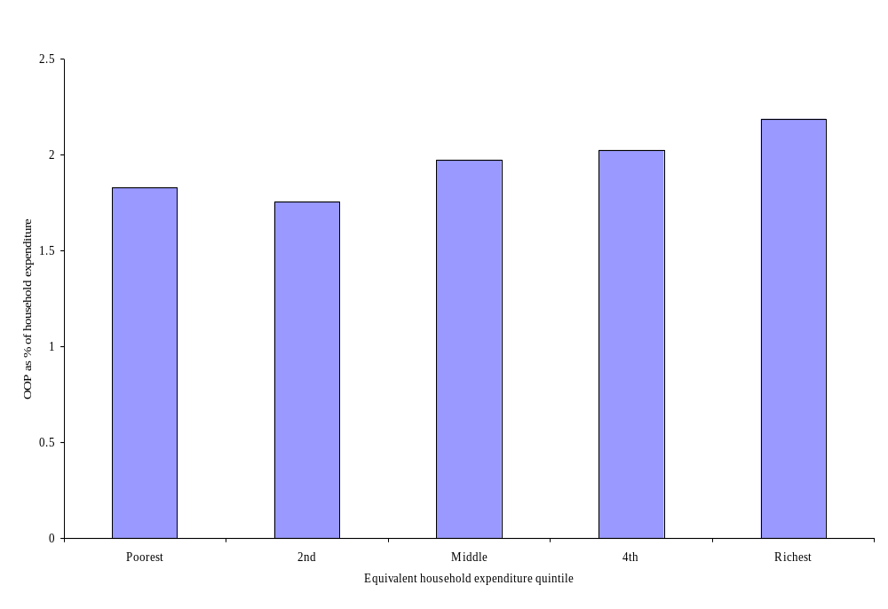
Assessing progressivity – a first pass
In Egypt, the share of OOP payments in total
expenditure is larger for
the top quintiles.
This indicates progressivity
Notes:
1. The most direct means of assessing progressivity of health payments is to examine their share of ATP as the latter varies. In the figure for Egypt we show OOP payments for health care as a percentage of total household expenditure by quintile groups of equivalent household expenditure. On average, OOP payments claim about 2 percent of household expenditures, and there is a tendency for this share to rise with total expenditure, indicating some progressivity.

Slide 7
Assessing progressivity across the full distribution
Health payments concentration curve (L_{H}(p)) plots the cumulative % of health payments against the cumulative % of the population ranked by ATP
Assess progressivity by comparing L_{H}(p) with the Lorenz curve of ATP (L(p))
L_{H}(p) everywhere on top of L(p) → proportionality
L_{H}(p) everywhere below L(p) → progressivity
L_{H}(p) everywhere above (dominates) L(p) → regressivity
Notes:
1. If payments toward health care always account for the same proportion of ATP, then the share of health payments contributed by any group must correspond to its share of ATP. The concentration curve lies on top of the Lorenz curve. Under a progressive system, the share of health payments contributed by the poor will be less than their share of ATP. The Lorenz curve dominates (lies above) the concentration curve. The opposite is true for a regressive system.

Slide 8
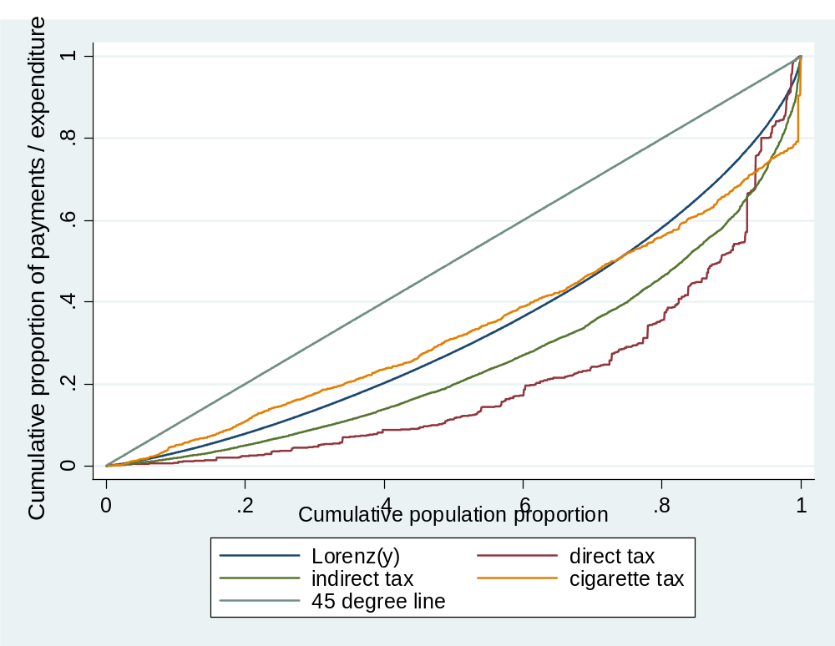
Incidence of direct, indirect and cigarette taxes in Egypt, 1997
Lorenz curve appears
to dominate conc.
curves for direct &
indirect taxes
Progressivity
Conc. curve for cig.
tax intersects Lorenz →
no conclusion
Notes:
Health care in Egypt is financed from a number of sources. As is common for developing countries, OOP payments contribute the greatest share of revenue, 52 percent in this case. The next biggest contribution—one-third—is from general government revenues. Social and private health insurance contribute 7 percent and 5.5 percent, respectively, and an earmarked health tax on cigarette sales makes up the remaining 3 percent of revenues going toward the provision of health care.
We assess the progressivity of this system of health finance using data from the 1997 Egypt Integrated Household Survey. In instances in which it is feasible, the incidence assumptions stated above are applied. Payment variables recorded in the survey are as follows: (i) direct personal taxes (income, land, housing, and property taxes), (ii) OOP medical expenses, and (iii) private health insurance premiums. Payment variables estimated from other survey information were (i) sales and cigarette taxes approximated by applying rates to the corresponding expenditures and (ii) social health insurance contributions estimated by applying contribution rates to earnings/incomes of covered workers/pensioners. ATP is approximated by equivalent household expenditure; calculated as total household expenditure, plus direct tax and social insurance contributions, divided by the square root of household size.
In the figures we present the concentration curves for each source of finance, as well as the Lorenz curve for household expenditure. In the figure the concentration curves for direct and indirect taxes appear to lie outside the Lorenz curve, suggesting that these are progressive sources of finance.
Formal tests of dominance will be reported below.
The curve for the earmarked cigarette tax appears to lie inside the Lorenz curve at lower ATP but outside it at higher ATP.

Slide 9
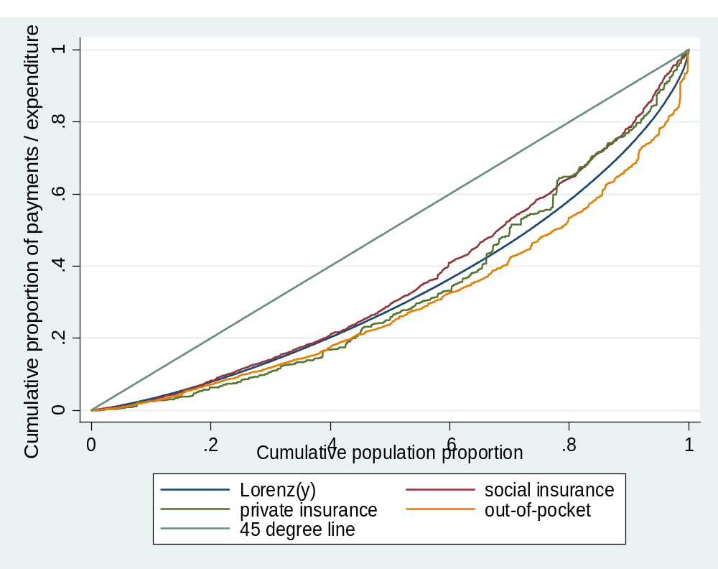
Incidence of social & private insurance, and OOP payments in Egypt, 1997
Lorenz appears to
dominate OOP conc.
curve → progressivity
Lorenz appears
dominated by SI conc.
curve → regressivity
Lorenz and PI conc.
curve intersect → no
conclusion
Notes:
We present the concentration curves for social insurance contributions, private insurance premiums, and OOP payments. The latter concentration curve appears to lie outside the Lorenz curve.
Although the concentration curve for private insurance premiums appears to lie below the Lorenz curve at lower ATP, the opposite is true at higher ATP.
The concentration curve for social insurance contributions is almost exactly on top of the Lorenz curve (indicating proportionality) up to the middle of the ATP distribution but lies inside the Lorenz curve for the top half of the distribution.

Slide 10
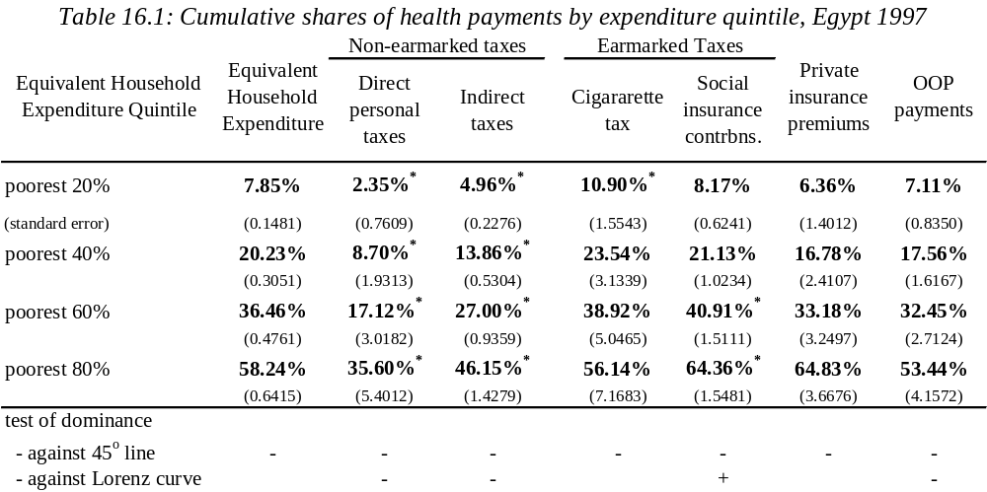
Distributional Incidence of Health Finance in Egypt, 1997 – Quintile shares and dominance tests
Notes:
1. For shares: bold indicates significant difference from population share (5%)
* indicates significant difference from expenditure share (5%).
2. Dominance tests were covered in lecture 7: - indicates the 45 degree line / Lorenz curve dominates the concentration curve + indicates concentration curve dominates 45 degree line / Lorenz curve
blank indicates non-dominance.
3. Dominance is rejected if there is at least one significant difference in one direction and no significant difference in the other, with comparisons at 19 quantiles and 5% significance level.
The formal tests confirm that the Lorenz curve dominates both of the concentration curves for direct and indirect taxes. The table also reveals that the cumulative shares of direct and indirect taxes paid at each of the first four quintiles are always significantly less the respective shares of ATP. Again, confirming progressivity.
The curve for the earmarked cigarette tax appears to lie inside the Lorenz curve at lower ATP but outside it at higher ATP. The test does not reject the null of nondominance, and therefore proportionality, in this case. Apparently, the difference between the two curves never reaches statistical significance at any point.
The test confirms that the Lorenz dominates the OOP concentration curve. However, unlike for direct and indirect taxes, the cumulative share of OOP payments is not significantly different from the share of ATP at any of the quintiles.
Although the concentration curve for private insurance premiums appears to lie below the Lorenz curve at lower ATP, the opposite is true at higher ATP. In fact, the test does not reject nondominance (/proportionality).
The concentration curve for social insurance contributions is almost exactly on top of the Lorenz curve (indicating proportionality) up to the middle of the ATP distribution but lies inside the Lorenz curve for the top half of the distribution. This pattern in the top of the distribution leads to the test finding dominance of the concentration curve over the Lorenz curve and so regressivity. The quintile shares confirm that the significant differences are at the higher quintiles.
In summary, there is evidence that direct and indirect taxes plus OOP payments are progressive means of financing health care in Egypt. There is no evidence that the earmarked cigarette tax and private insurance premiums depart significantly from proportionality. Social insurance premiums are regressive but only at the top of the distribution.
[1] Despite this, the test finds dominance because we use the multiple comparison approach decision rule, which requires only one significant difference from, in this case, 19 quantile comparison points (see chapter 7).

Slide 11
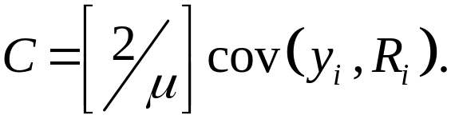
Measuring Progressivity
Summary indices of progressivity useful for making comparisons.
Kakwani index = 2* area between Conc. curve and Lorenz curve = Concentration Index – Gini.
  Min = -2, Max = 1
  Kakwani > 0 → progressive
  Kakwani = 0 → proportional (but can also arise with intersecting curves)
  Kakwani < 0 → regressive
C and Gini can calculated by
Notes:
Lorenz dominance analysis is the most general way of detecting departures from proportionality and identifying their location in the ATP distribution. But it does not provide a measure of the magnitude of progressivity, which may be useful when making comparisons across time or countries. Summary indices of progressivity meet this deficiency but require the imposition of value judgments about the weight given to departures from proportionality at different points in the distribution (Lambert 1989). The Kakwani index (Kakwani 1977) is the most widely used summary measure of progressivity in both the tax and the health finance literatures (O’Donnell et al. 2005; Wagstaff et al. 1992; Wagstaff et al. 1999).
In the case of proportionality, the concentration lies on top of the Lorenz curve and the index is zero. But note that the index could also be zero if the curves were to cross and positive and negative differences between them cancel. Given this, it is important to use the Kakwani index, or any summary measure of progressivity, as a supplement to, and not a replacement of, the more general graphical analysis.
In a generalized Kakwani index, the judgment about the weight given to departures from proportionality along the ATP distribution is made explicit through the choice of a parameter (Lambert 1989). An alternative to the simple Kakwani is the Suits index, which gives greater weight to departures from proportionality that occur among households higher up the ATP distribution (Suits 1977).

Slide 12
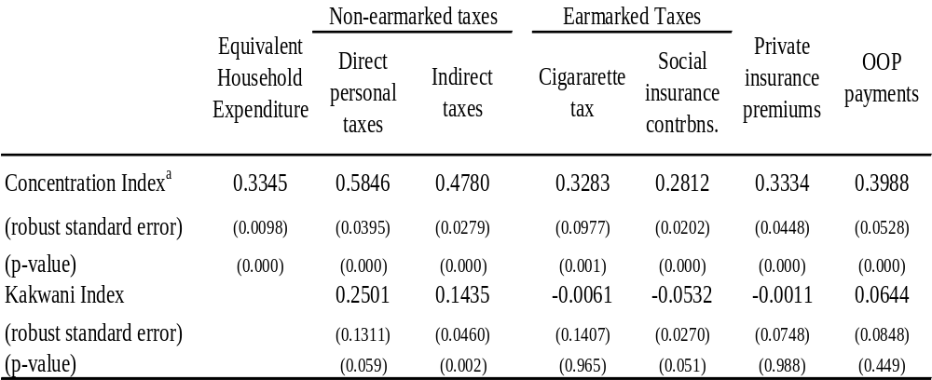
Measures of progressivity of health finance in Egypt, 1997
Notes:
Concentration and Kakwani indices by source of health financing in Egypt are given in the bottom part of the table in box 16.1. All concentration indices are significantly positive confirming, as was clear from the concentration curves and dominance tests, that the better-off contribute absolutely more to the financing of health care than do the poor. The index is largest for direct payments and smallest for social insurance contributions, suggesting that direct taxes are most progressive and social insurance contributions the least so. The Kakwani indices for both direct and indirect tax are statistically significantly positive, marginally so in the case of direct taxes (10 percent), indicating progressivity. For the cigarette tax, private insurance, and OOP payments, the Kakwani indices are not significantly different from zero. In the latter case, this seems inconsistent with the result of the dominance test, which indicates that the OOP concentration curve is dominated by the Lorenz curve. The explanation would appear to be that the curves differ in the top half of the ATP distribution but are near coincident in the bottom half, where the Kakwani index places more weight. The Kakwani index for social insurance contributions is significantly negative at just above the 5 percent significance level. Again, the magnitude of the index is reduced by the near proportionality in the bottom half of the ATP distribution.
Standard errors for concentration and Kakwani indices are robust to heteroscedasticity and within cluster correlation.
a. Gini index for equivalent household expenditure.

Slide 13
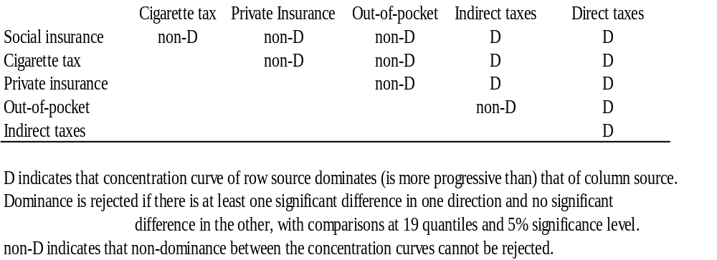
Relative progressivity of different source of finance in Egypt, 1997
Tests of Dominance between Concentration Curves
for Different Sources of Health Finance
Notes:
1. We can formally test for the relative progressivity of different sources of finance using dominance methods. The results, which are reported in the table, indicate that the concentration curve for direct taxes is dominated by all the others, and so we can conclude that direct taxes are the most progressive source of finance. Next come indirect taxes, the concentration curve for which is dominated by all the others but for OOP payments. There are no significant differences between the concentration curves for social insurance, private insurance, cigarette taxes, and OOP payments. These sources cannot be ranked in relation to progressivity.

Slide 14
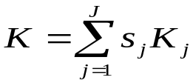
Measuring progressivity of overall health finance
Kakwani index is additively separable
So, Kakwani for total health finance can be computed as weighted average of those for each source
That is, where s_{j} is the share of total health finance contributed by source j
Ideally finance shares calculated from NHA
Shares of sources can be inflated to represent those for which the distribution cannot be estimated but is assumed to be distributed similarly
Sensitivity analysis should be conducted with respect to the weights
Notes:
1. Ideally, the macroweights should come from National Health Accounts (NHA). It is unlikely, however, that all sources of finance that are identified at the aggregate level can be allocated down to the household level from the survey data. Assumptions must be made about the distribution of sources of finance that cannot be estimated. Their distributional burden may be assumed to resemble that of some other payment source. For example, corporate taxes may be assumed to be distributed as income taxes. In this case, we say that the missing payment distribution has been allocated. Alternatively, we may simply assume that the missing payment is distributed as the weighted average of all the revenues that have been identified. We refer to this as ventilation. Best practice is to make such assumptions explicit and to conduct extensive sensitivity analysis.

Slide 15
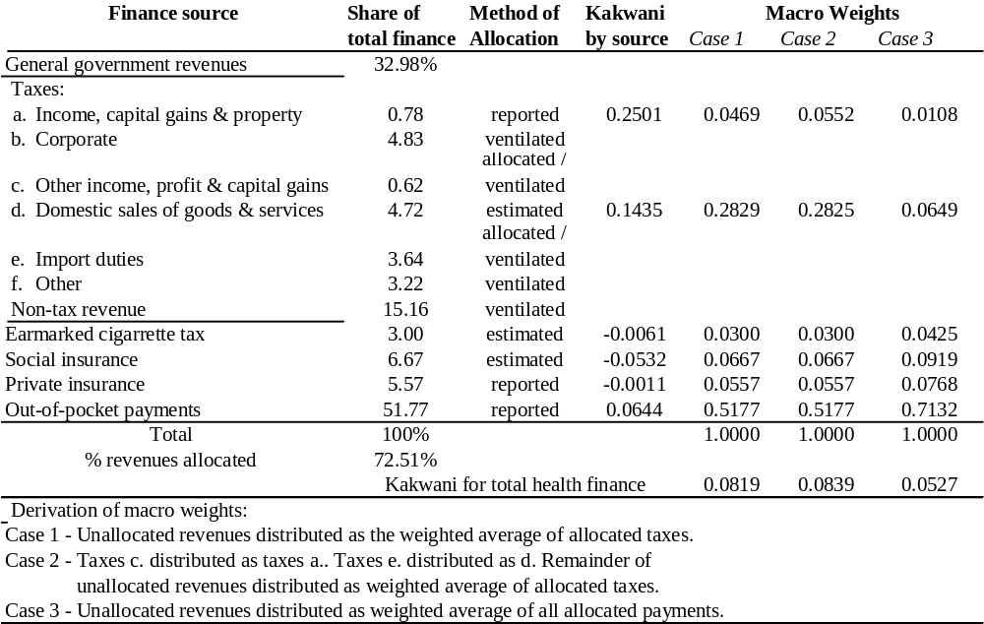
Progressivity of health finance by source and in total in Egypt, 1997
Notes:
The NHA shares of total health revenues in Egypt (1994–5) from various finance sources are given in the table . The table also shows which of the various finance sources can be allocated, either directly or through estimation, from the survey data. In this example, as in most others, the main difficulty concerns the allocation of the 33 percent of all health care finance that flows from general government revenues. Only direct personal and sales taxes, which account for only one-sixth of government revenues, can be allocated down to households. Nonetheless, it is possible to allocate to households, revenues that account for 72 percent of all health care finance.
We consider three sets of assumptions about the distribution of unallocated revenues. In case 1, it is assumed that unallocated general government revenues are distributed as the weighted average of those taxes that can be allocated. Essentially, this involves inflating the weight given to the taxes that can be allocated. For example, the weight on domestic sales taxes is inflated from its actual value of 0.0472 of all health finance to a value of 0.2829 (= [4.72/5.5]*0.3298) to reflect the distribution of unallocated revenues. In case 2, we assume that “other income, profits, and capital gains taxes” are distributed as direct personal taxes and that import duties are distributed as sales taxes. It is assumed that the rest of the unallocated revenues are distributed as the weighted average of the allocated taxes. Finally, in case 3, we assume that unallocated revenues are distributed as the weighted average of all allocated payments (and not just allocated taxes). Another interpretation of this case is that the Kakwani index is informative of the overall progressivity of only those health payments that can be allocated to households.
The relative emphasis given to such alternative scenarios should depend on evidence as to the relative validity of the underlying assumptions. In the example, the various assumptions about the distributions of the unallocated revenues makes little difference to the conclusion about the overall progressivity of the health finance system. In every case, the Kakwani index for total payments is only very slightly positive, indicating near proportionality.

Slide 16
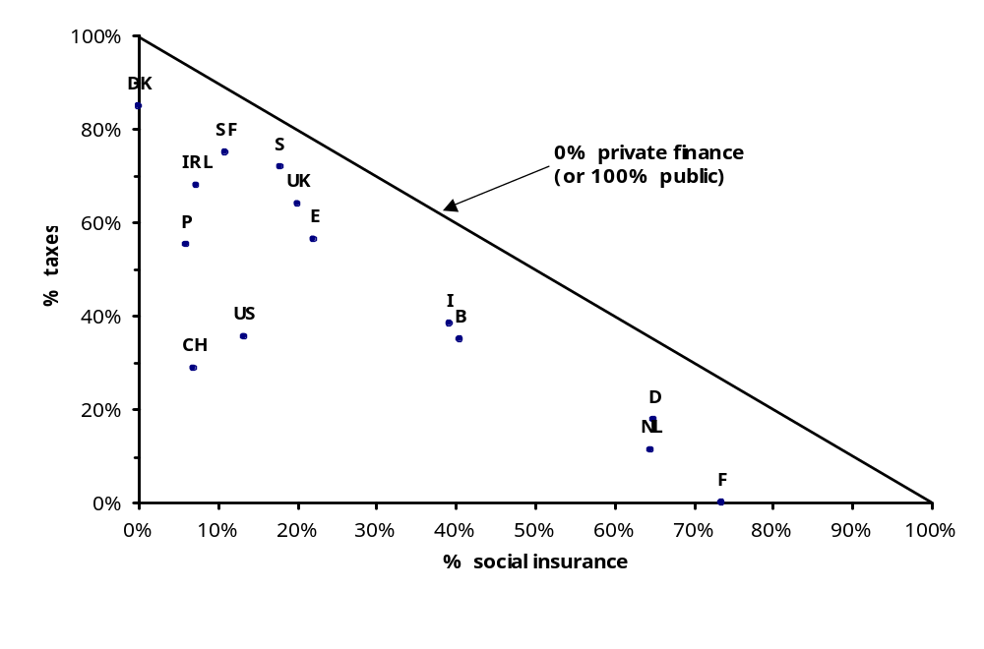
Health care financing triangle – OECD countries
Notes:
In the remaining slides we present some results from cross-country comparison studies of progressivity of health finance in OECD and Asian countries, which come from the ECuity and Equitap projects respectively.
This makes clear the different interpretation that should be placed on the progressivity analysis according to the means of financing health care and, in particular, whether access to health care is separated from financing.
Source: Wagstaff, A., E. van Doorslaer, H. van der Burg, S. Calonge, T. Christiansen, G. Citoni, U. G. Gerdtham, M. Gerfin, L. Gross, U. Hakinnen, P. Johnson, J. John, J. Klavus, C. Lachaud, J. Lauritsen, R. Leu, B. Nolan, E. Peran, J. Pereira, C. Propper, F. Puffer, L. Rochaix, M. Rodriguez, M. Schellhorn, G. Sundberg, and O. Winkelhake. 1999. “Equity in the Finance of Health Care: Some Further International Comparisons.” Journal of Health Economics 18(3): 263–90.
Data refer to early 1990s
Health care is financed from four sources - taxes, social insurance, private insurance and OOPs. The precise mix varies from country to country, as does .
Three clusters of countries emerge: (1) the tax-financed countries (i.e. DK, SF, IRL, P, E, S and the UK); (2) the social insurance countries (i.e. F, D and the NL); and (iii) the predominantly privately-financed countries (i.e. CH and US) where PI and OOPs raise over 50% of revenues.
Note that I is predominantly public, but is neither predominantly tax-financed nor predominantly social insurance, even though the government’s aim has been to move towards tax finance.
Note that in P, private finance now accounts for a very large share of revenues. Almost all is OOPs. Private insurance is not widespread in any of the southern European countries or in the Nordic countries.
In the SI countries, SI involves sickness funds. In some countries, the number of sickness funds is quite high. Contribution schedules can vary across funds (e.g. D). They also sometimes vary according to employment status (e.g. pensioners exempt in D and NL but not in F) and according to professional status (e.g. in I).
In some countries, PI provides double cover (e.g. the UK). In some, it provides cover to those who have incomplete public cover (e.g. D, IRL and NL). In others still, it provides cover against copayments (e.g. DK and F).
In some countries OOPs are income-related (e.g. the UK). In some, they vary according to locality (e.g. SF and S).

Slide 17
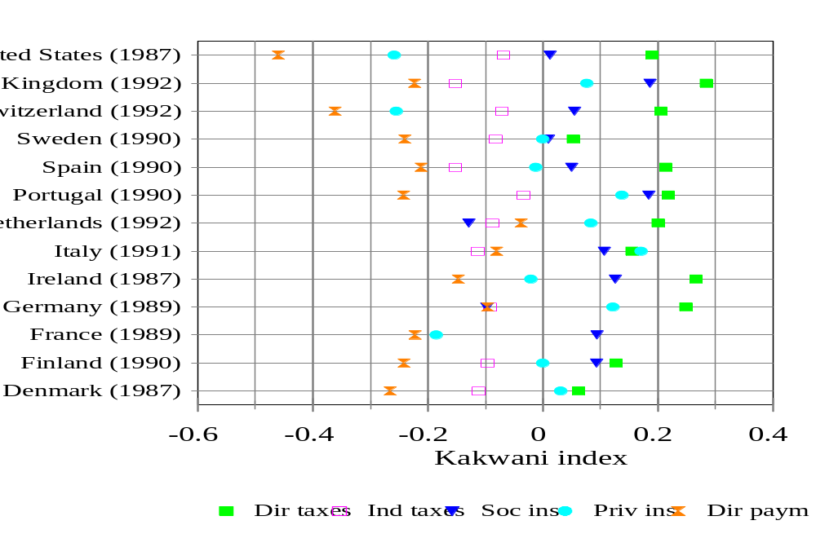
Progressivity by source — OECD countries, early 90s
Notes:
Taxes are proportional or mildly progressive. Low degree of progressivity in Nordic countries reflects emphasis on proportional local income tax in financing health care in those countries.
SI is regressive in two of the three SI countries (namely D and NL) but not in F. This probably reflects the fact that in D and NL the upper income groups are excluded from or opt out of part of the SI scheme, whereas in F, the SI scheme covers all income groups. In other countries SI is progressive on equivalent income, despite the ceilings that often exist on contributions schedules. Sometimes, SI is more progressive than general taxation, reflecting the facts that (i) general taxes include indirect taxes which are regressive and (ii) the Nordic countries rely heavily on a proportional local income tax to finance health care.
PI is regressive in countries where it is the principal source of cover for a sizable part of the population, i.e. CH and US. In D and NL its progressiviness reflects the fact that PI is bought by the higher income groups who have opted out or have been excluded from part of the SI scheme. In other countries, its progressiveness reflects the fact that it is bought by the better-off as double cover, e.g. in I and the UK.
OOPs are regressive and usually the most regressive form of finance. In some countries -- e.g. IRL, I and the UK -- the regressiveness is reduced by the linking of OOPs to income. The low degree of regressiveness of OOPs in the NL reflects the fact that OOPs are often made by the privately insured better-off who opt for lower premiums in exchange for higher deductibles.

Slide 18
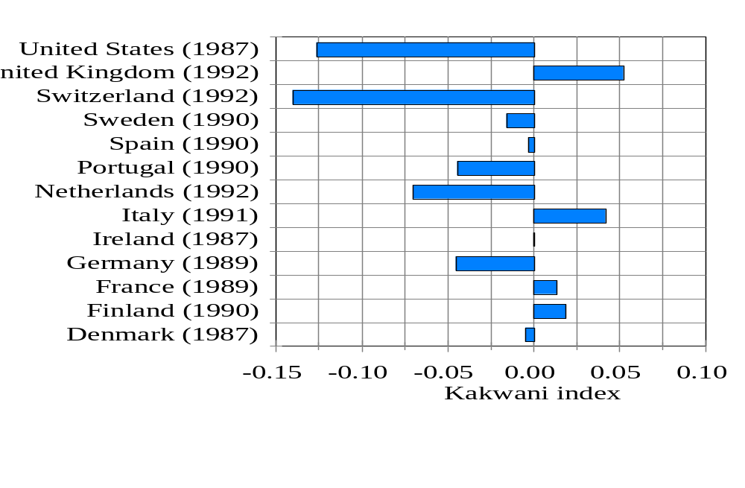
Overall progressivity — OECD countries, latest year
Notes:
Most regressive in the private insurance dominated systems (US & Swiss)
More progressive in the tex dominated systems (UK and Italy)
Slightly regressive in the European social insurance systems.

Slide 19
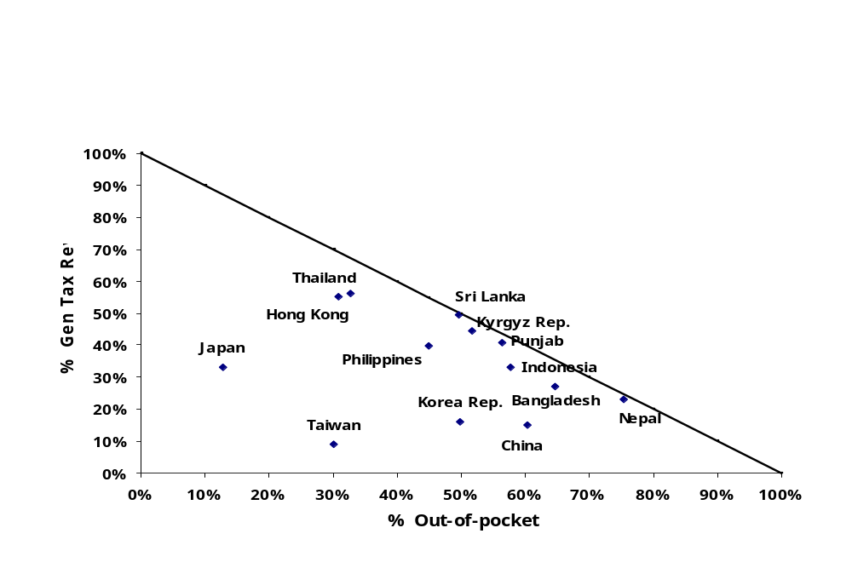
Health care financing triangle – Asia
Notes:
Source: O’Donnell, O., E. van Doorslaer, R. Rannan-Eliya, A. Somanathan, S. R. Adhikari, B. Akkazieva, D. Harbianto, C. G. Garg, P. Hanvoravongchai, A. N. Herrin, M. N. Huq, S. Ibragimova, A. Karan, S.-M. Kwon, G. M. Leung, J.-F. R. Lu, Y. Ohkusa, B. R. Pande, R. Racelis, K. Tin, L. Trisnantoro, C. Vasavid, Q. Wan, B.-M. Yang, and Y. Zhao. 2008. “Who Pays for Health Care in Asia?” Journal of Health Economics, forthcoming
The axes of this diagram are different to those for the triangle for OECD countries. Since OOP payments are the main source of finance in most countries and social insurance is limited in the lower income countries, we place OOP payments and tax funding on the axes.
Distances from the hypotenuse are due to private and social insurance. These sources are more significant in the higher income countries.

Slide 20
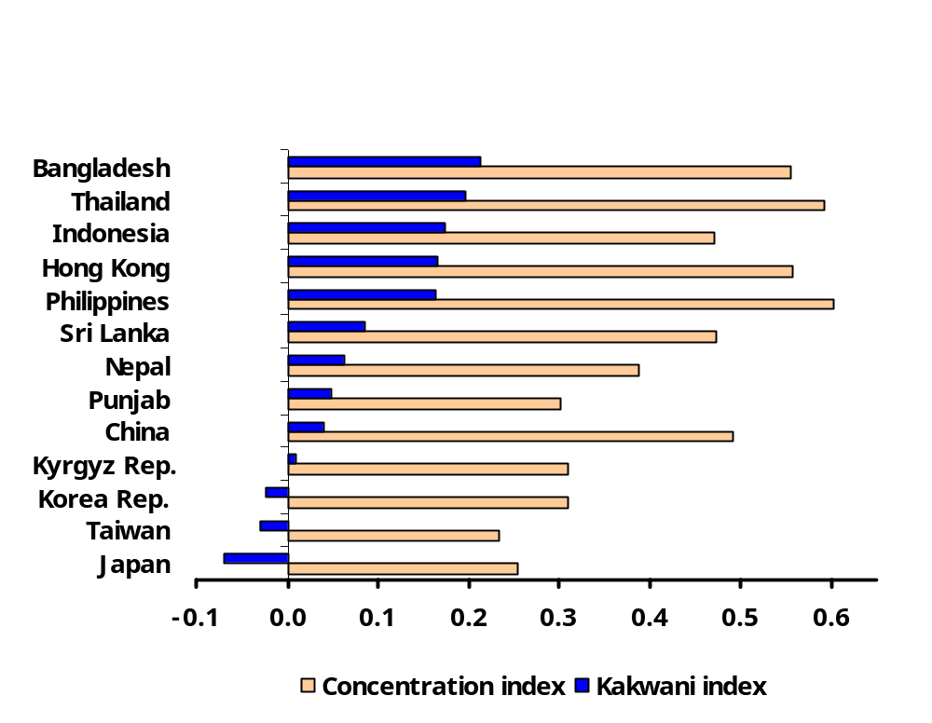
Inequality and progressivity – total health care payments, Asia
Notes:
The concentration and Kakwani indices for total health payments are shown. The concnetration indices show that in all countries the better-off contribute absolutely more to health care finance. In Hong Kong and the lower income countries the better-off also pay more as a proportion of their ability to pay – the Kakwani indices are positive. In the higher income countries with social insurance, there is slight regressivity in payments.
The results for the higher income countries relying on social insurance are similar to those for other OECD countries – slight regressivity. But thosew for the lower/middle income countries are very different from those for the OECD. But the heavy reliance on OOP means that the interpretation of the distributions must also be different. The better-off pay proportionately more for health care in these lower income countries, but they also get more health care. When access to health care is not separated from payment, the interpretation of progressivity results differ.

